Slide 1
Chapter 10: DHCP
Routing and Switching Essentials
Notes:
Cisco Networking Academy program
Routing and Switching Essentials
Chapter 10: DHCP

Slide 2
Chapter 10
10.0 Introduction
10.1 Dynamic Host Configuration Protocol v4
10.2 Dynamic Host Configuration Protocol v6
10.3 Summary
Notes:
Chapter 10

Slide 3
Chapter 10: Objectives
Describe the operation of DHCPv4 in a small-to-medium sized business network.
Configure a router as a DHCPv4 server.
Configure a router as a DHCPv4 client.
Troubleshoot a DHCP configuration for IPv4 in a switched network.
Explain the operation of DHCPv6.
Configure a stateless DHCPv6 for a small to medium-sized business.
Configure a stateful DHCPv6 for a small to medium-sized business.
Troubleshoot a DHCP configuration for IPv6 in a switched network.
Notes:
Chapter 10 Objectives

Slide 4
Introduction Introduction
Dynamic Host Configuration Protocol (DHCP) is a network protocol that provides automatic IP addressing and other information to clients:IP address
Subnet mask (IPv4) or prefix length (IPv6)
Default gateway address
DNS server address
Available for both IPv4and IPv6
This chapter explores the functionality, configuration, and troubleshooting of both DHCPv4 and DHCPv6
Notes:
10.0 Introduction
10.0.1.1 Introduction

Slide 5
DHCPv4 Operation Introducing DHCPv4
DHCPv4 uses three different address allocation methods
Manual Allocation - The administrator assigns a pre-allocated IPv4 address to the client, and DHCPv4 communicates only the IPv4 address to the device.
Automatic Allocation - DHCPv4 automatically assigns a static IPv4 address permanently to a device, selecting it from a pool of available addresses. No lease.
Dynamic Allocation - DHCPv4 dynamically assigns, or leases, an IPv4 address from a pool of addresses for a limited period of time chosen by the server, or until the client no longer needs the address. Most commonly used.
Notes:
10.1 DHCP v4
10.1.1 DHCPv4 Operation
10.1.1.1Introducing DHCPv4

Slide 6
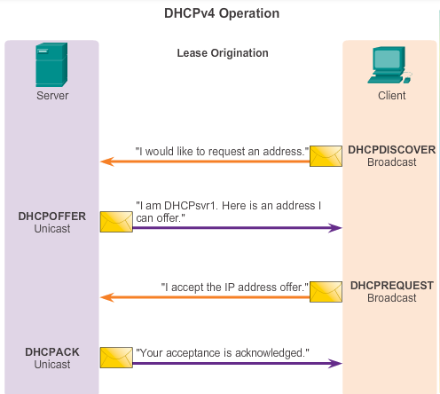
DHCPv4 Operation Introducing DHCPv4
Notes:
10.1 DHCP v4
10.1.1 DHCPv4 Operation
10.1.1.2 DHCPv4 Operation

Slide 7
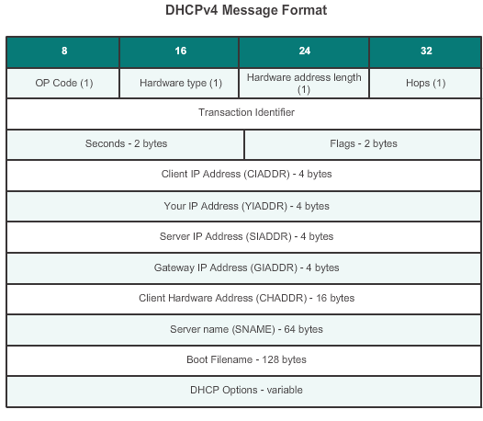
DHCPv4 Operation DHCPv4 Message Format
Notes:
10.1 DHCP v4
10.1.1 DHCPv4 Operation
10.1.1.3Introducing DHCPv4

Slide 8
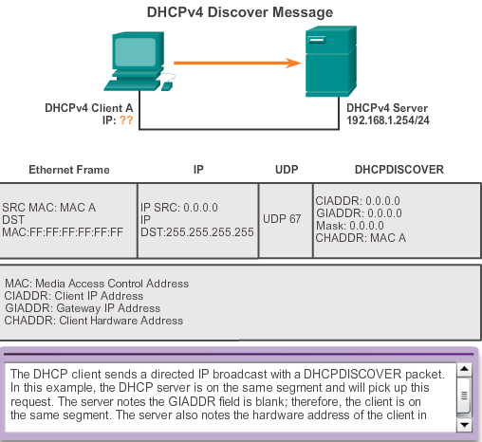
DHCPv4 Operation DHCPv4 Discover and Offer Messages
Notes:
10.1 DHCP v4
10.1.1 DHCPv4 Operation
10.1.1.4 DHCPv4 Discover and Offer Messages

Slide 9
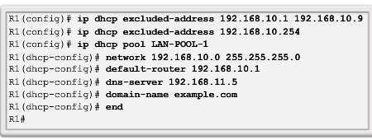
DHCPv4 Operation Configuring a DHCPv4 Server
A Cisco router running Cisco IOS software can be configured to act as a DHCPv4 server. To set up DHCP
1.Exclude addresses from the pool.
2. Set up DHCP pool name
3. Configuring Specific Tasks –define range of addresses and subnet mask. Use default-router command for default gateway. Optional items that can be included in pool – dns server, domain-name
To disable dhcp - no service dhcp
Notes:
10.1 DHCP v4
10.1.1 DHCPv4 Operation
10.1.2.1 Configuring a DHCPv4 Server

Slide 10
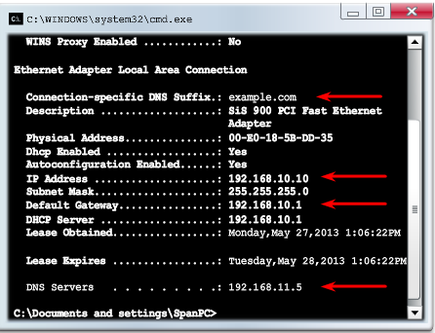
DHCPv4 Operation Verifying a DHCPv4 Server
Commands to verify DHCP
show running-config | section dhcp
show ip dhcp binding
show ip dhcp server statistics
On the PC –issue the ipconfig /all command
Notes:
10.1 DHCP v4
10.1.2Configure DHCPv4 Server
10.1.2.2 Verifying a DHCPv4 Server

Slide 11
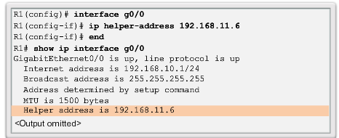
DHCPv4 Operation DHCPv4 Relay
Using an IP helper address enables a router to forward DHCPv4 broadcasts to the DHCPv4 server. Acting as a relay.
Notes:
10.1 DHCP v4
10.1.2Configure DHCPv4 Server
10.1.2.3 DHCPv4 Relay

Slide 12
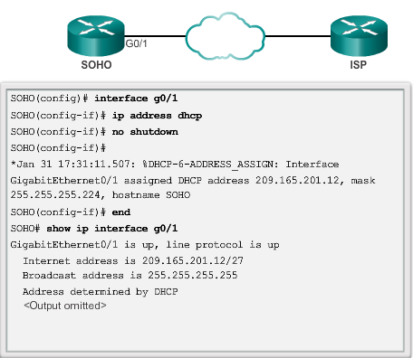
Configuring a DHCPv4 client Configuring a Router as DHCPv4 client
Notes:
10.1 DHCP v4
10.1.3 Configuring a DHCPv4 client
10.1.3.1 Configuring a Router as DHCPv4 Client

Slide 13
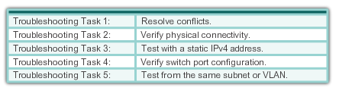
Troubleshoot DHCPv4 Troubleshooting Tasks
Notes:
10.1 Managing IOS System Files
10.1.4 Troubleshoot DHCPv4
10.1.4.1 Troubleshooting Tasks

Slide 14
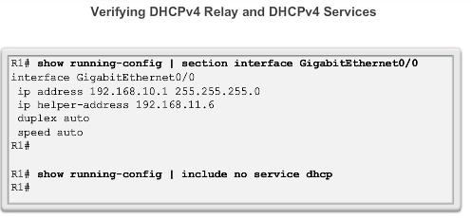
Troubleshoot DHCPv4 Verify Router DHCPv4 Configuration
Notes:
10.1 Managing IOS System Files
10.1.4 Troubleshoot DHCPv4
10.1.4.2 Verify Router DHCPv4 Configuration

Slide 15
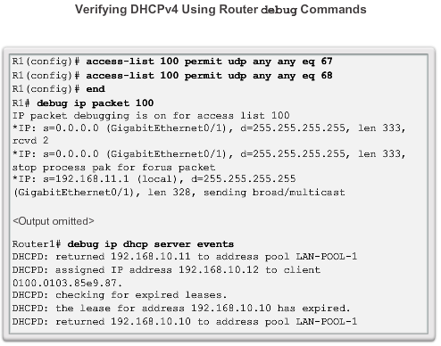
Troubleshoot DHCPv4 Debugging DHCPv4
Notes:
10.1.4 Troubleshoot DHCPv4
10.1.4.3 Debugging DHCPv4

Slide 16
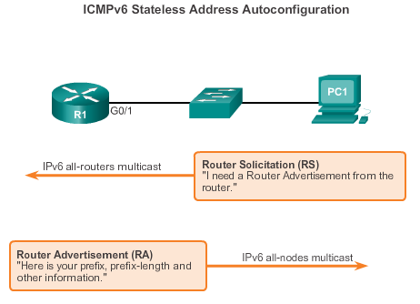
SLAAC and DHCPv6 Stateless Address Autoconfiguration (SLAAC)
SLAAC is a method in which a device can obtain an IPv6 global unicast address without the services of a DHCPv6 server.
Notes:
10.2 DHCP v6
10.2.1 SLAAC and DHCPv6
10.2.1.1 Stateless Address Autoconfiguration (SLAAC)

Slide 17
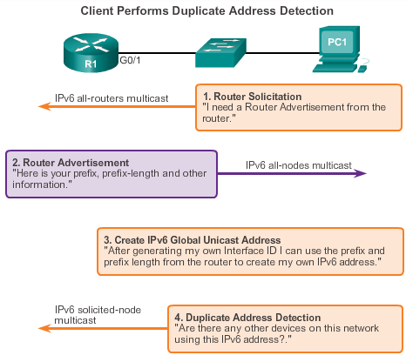
SLAAC and DHCPv6 SLAAC Operation
Notes:
10.2 DHCP v6
10.2.1 SLAAC and DHCPv6
10.2.1.2 SLAAC Operation

Slide 18
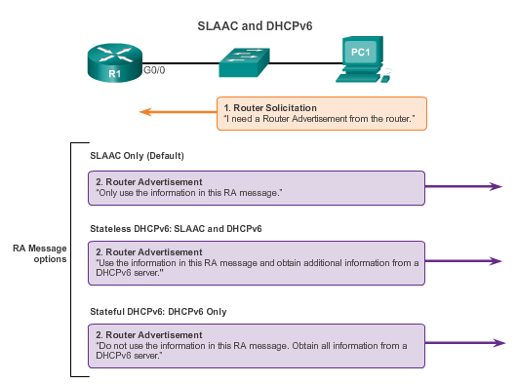
SLAAC and DHCPv6 SLAAC and DHCPv6
Notes:
10.2 DHCP v6
10.2.1 SLAAC and DHCPv6
10.2.1.3 SLAAC and DHCPv6

Slide 19
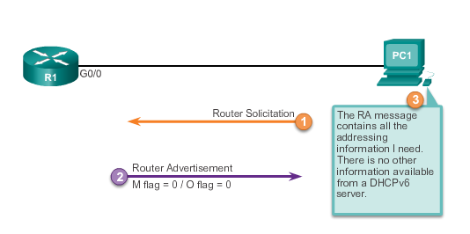
SLAAC and DHCPv6 SLAAC Option
Notes:
10.2 DHCP v6
10.2.1 SLAAC and DHCPv6
10.2.1.4 SLAAC Option

Slide 20
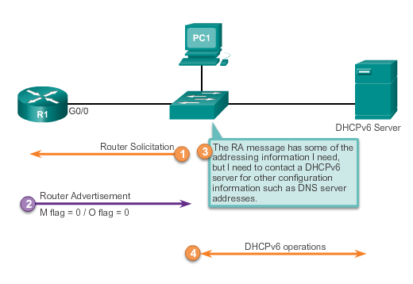
SLAAC and DHCPv6 Stateless DHCP Option
Notes:
10.2 DHCP v6
10.2.1 SLAAC and DHCPv6
10.2.1.5 Stateless DHCP Option

Slide 21
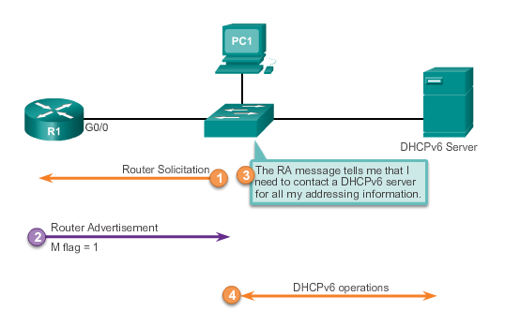
SLAAC and DHCPv6 Stateful DHCP Option
Notes:
10.2 DHCP v6
10.2.1 SLAAC and DHCPv6
10.2.1.6 Stateful DHCP Option

Slide 22
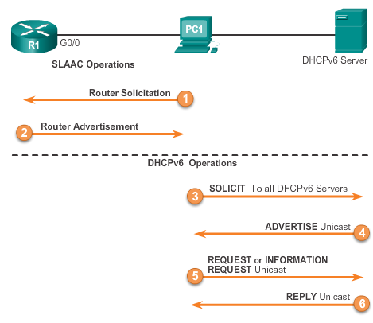
SLAAC and DHCPv6 DHCPv6 Operations
Notes:
10.2 DHCP v6
10.2.1 SLAAC and DHCPv6
10.2.1.7 DHCPv6 Operations

Slide 23
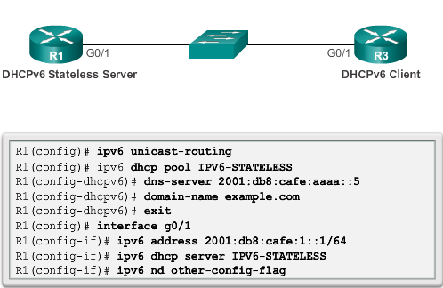
Stateless DHCPv6 Configuring a Router as a Stateless DHCPv6 Server
Notes:
10.2 DHCP v6
10.2.2 Stateless DHCPv6
10.2.2.1 Configuring a Router as a Stateless DHCPv6 Server

Slide 24
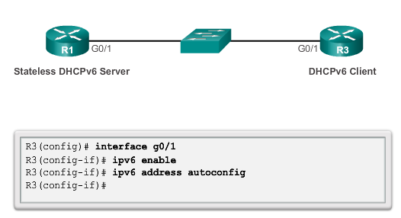
Stateless DHCPv6 Configuring a Router as a Stateless DHCPv6 Client
Verify the Stateless DHCP Client using:
Show IPv6 interface
Debug ipv6 dhcp detail
Notes:
10.2 DHCP v6
10.2.2 Stateless DHCPv6
10.2.2.2 Configuring a Router as a Stateless DHCPv6 Client
10.2.2.3 Verifying

Slide 25
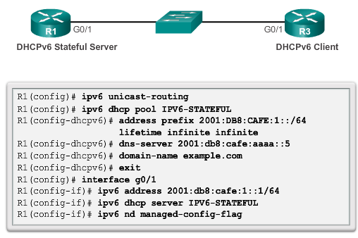
Stateful DHCPv6 Configuring a Router as a Stateful DHCPv6 Server
Notes:
10.2 DHCP v6
10.2.3 Stateful DHCPv6 Server
10.2.3.1 Configuring a Router as a Stateful DHCPv6 Server

Slide 26
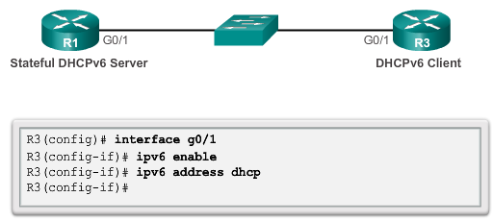
Stateful DHCPv6 Configuring a Router as a Stateful DHCPv6 Client
Verify Stateful DHCPv6 Server using:
show ipv6 dhcp pool
show ipv6 dhcp binding
Verify Stateful DHCPv6 client using:
show ipv6 interface
Notes:
10.2 DHCP v6
10.2.3 Stateful DHCPv6 Server
10.2.3.2 Configuring a Router as a Stateful DHCPv6 Client
10.2.3.3. Verifying

Slide 27
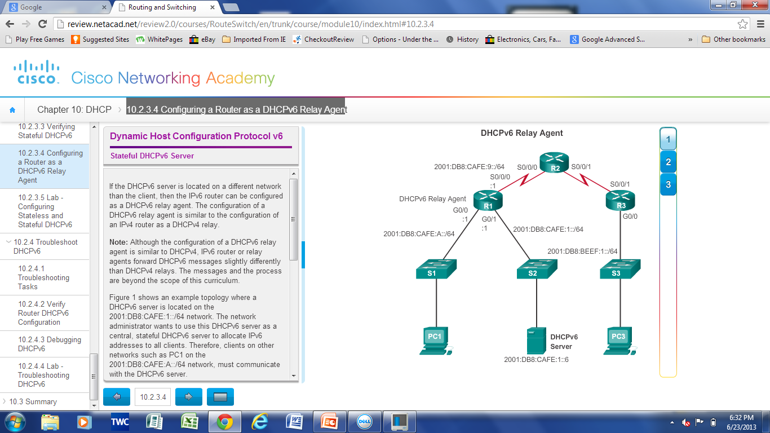
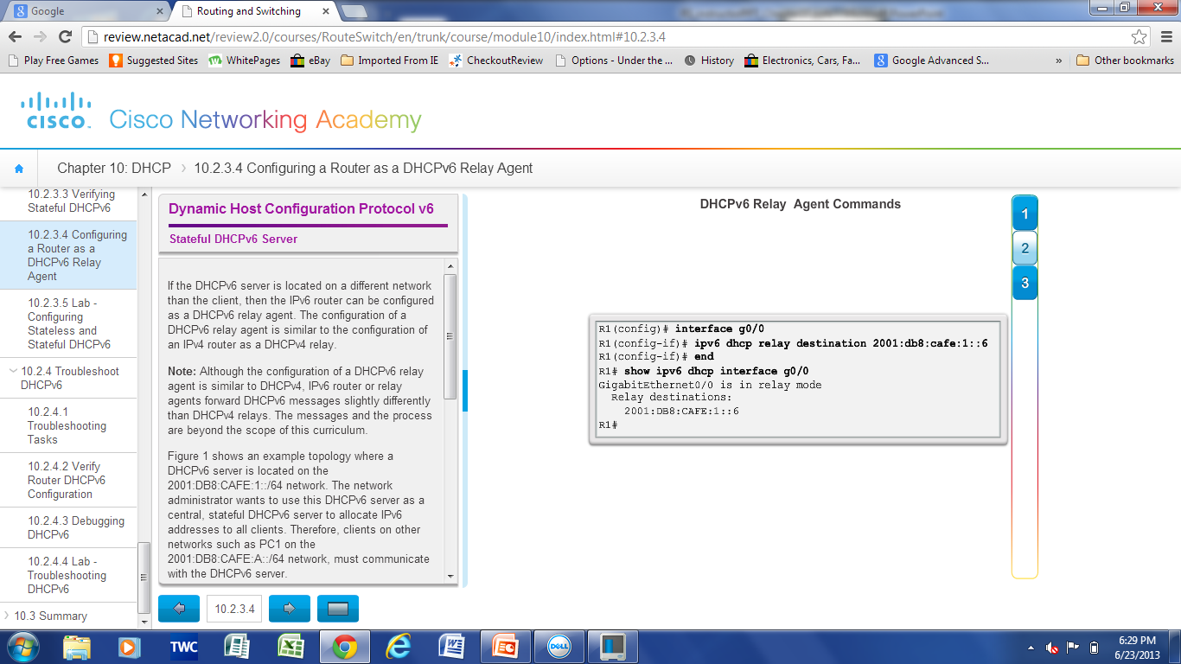
Stateful DHCPv6 Config a Router as a Stateful DHCPv6 Relay Agent
Notes:
10.2 DHCP v6
10.2.3 Stateful DHCPv6 Server
10.2.3.4 Configuring a Router as a DHCPv6 Relay Agent

Slide 28
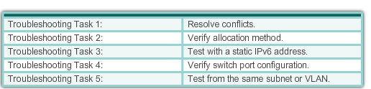
Troubleshooting DHCPv6 Troubleshooting Tasks
Notes:
10.2 DHCP v6
10.2.4 Troubleshoot DHCPv6
10.2.4.1 Troubleshooting Tasks

Slide 29
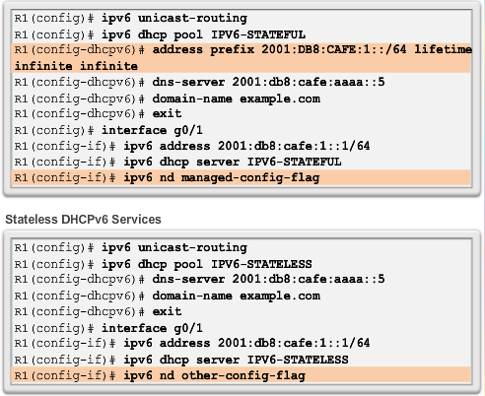
Troubleshooting DHCPv6 Verify Router DHCPv6 Configuration
Notes:
10.2 DHCP v6
10.2.4 Troubleshoot DHCPv6
10.2.4.2 Verify Router DHCPv6 Configuration

Slide 30
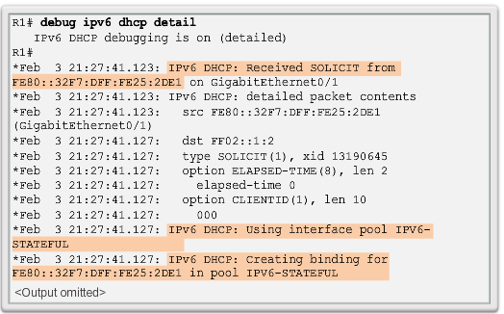
Troubleshooting DHCPv6 Debugging DHCPv6
Notes:
10.2 DHCP v6
10.2.4 Troubleshoot DHCPv6
10.2.4.3 Debugging DHCPv6

Slide 31
Chapter 10: Summary
All nodes on a network require a unique IP address to communicate with other devices.
DHCPv4 includes three different address allocation methods:
Manual Allocation
Automatic Allocation
Dynamic Allocation
There are two methods available for the dynamic configuration of IPv6 global unicast addresses.
Stateless Address Autoconfiguration (SLAAC )
Dynamic Host Configuration Protocol for IPv6 (Stateful DHCPv6)
Notes:
Chapter 10 Summary

Slide 32
Chapter 10: Summary (Continued)
The same tasks are involved when troubleshooting DHCPv4 and DHCPv6:
Resolve Address Conflicts
Verify Physical Connectivity
Test Connectivity using a Static IP Address
Verify Switch Port Configuration
Test Operation on the Same Subnet or VLAN
Notes:
Chapter 10 Summary

Slide 33


